Slide 1
CityBikes
Project
Nikola Golubovic

Slide 2
Motivation
The city of Hamilton, is an up-and-coming city on the shore of lake Ontario. With increased investment into public transportation, Hamilton is slowly becoming more and more pedestrian and bike friendly.
We will be looking into the Bike Share system that currently exists, and trying to determine which Bike Hubs are in good locations based on nearby Points of Interest.

Slide 3
Agenda
01
API Connection
02
Database
03
Visualize
04
Conclusions
We will be using the CityBikes API to get locations of HUBs in Hamilton, ON and then using the Foursquare and Yelp APIs to gather info on nearby POIs.
Information will be gathered and cleaned, and a database will be created that contains the nearby POI information.
Once the database is created, the info will be used to create an interactive map that shows all the HUBs along with their distance to nearby POIs and their ratings.
Using the maps, we will attempt to determine which parts of the city have both the closest POIs and the most highly rated.

Slide 4
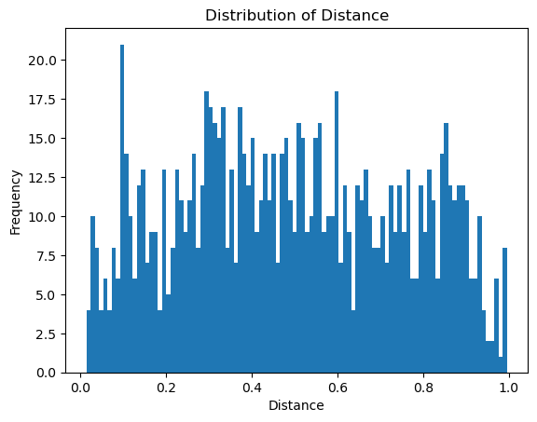
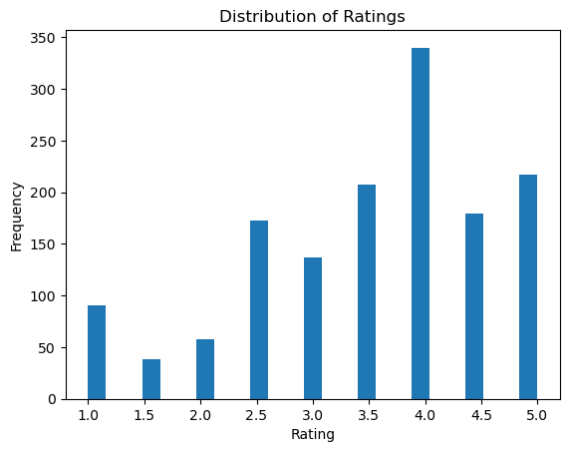
Data Sorting
The POIs were sorted based on the distance to the HUB with a limit of 10 POIs per HUB
The Haversine formula was used to find the difference in latitude and longitude between the points and determine the distance
Overall, the ratings of the 10 closest POIs was very good, showing an overall positive trend

Slide 5
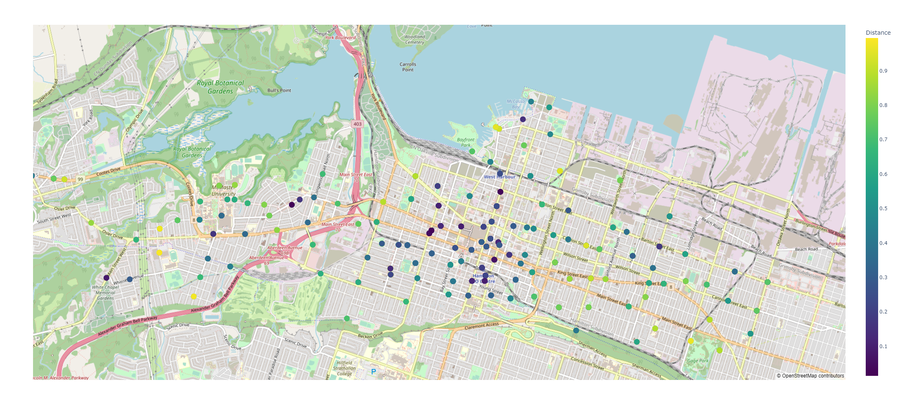
Maps, maps, maps

Slide 6
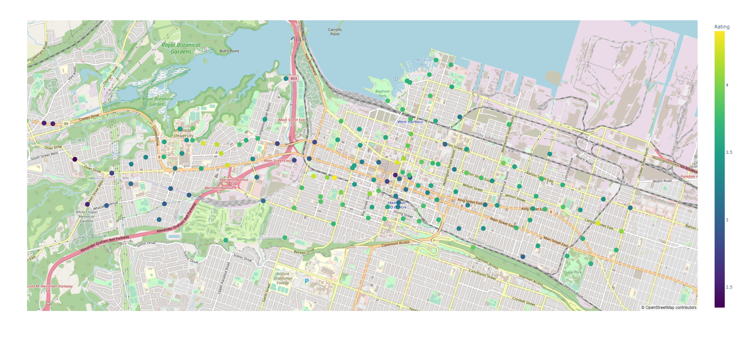
Maps, maps, maps

Slide 7
Conclusions
I learned about API’s and how to query websites.
Created a useful tool that I will put into practice when considering nights out in my town.
Confirmed the hypothesis that some parts of the city are just better than others.
Connected the dots on how to use Python to acquire and manipulate data and how to use SQL to store and manage data, and how those two things are interrelated.

